Slide 1
Biquad Realization
Linear Circuit Analysis II
EECE 202 – Spring 2025

Slide 2
Announcement
PD 1 Voice Over PPT due in Week 10
GCA2 – Group Week 11 Lecture 2

Slide 3
Recap
Transfer function of LP, BP, and HP filter
New Material
Active vs passive filters
Types of active filters
Butterworth filter

Slide 4
Passive vs Active Filters
Passive filters are built from passive components like resistors, capacitors and inductors.
Active filters are made from active components like amplifiers in addition to passive components.
Active filters require a power source to operate, whereas passive filters don’t.
The output of passive filters changes with the load, whereas active filters maintain their performance irrespective of the load connected.
Passive filters cannot apply additional gain to the signal, whereas active filters can.
Even if no gain is applied, active filters maintain the signal amplitude, whereas passive filters attenuate the entire signal.

Slide 5
Common Type of Filters
Butterworth (binomial)
Chebyshev (type I)
Chebyshev (type II)
Elliptic

Slide 6
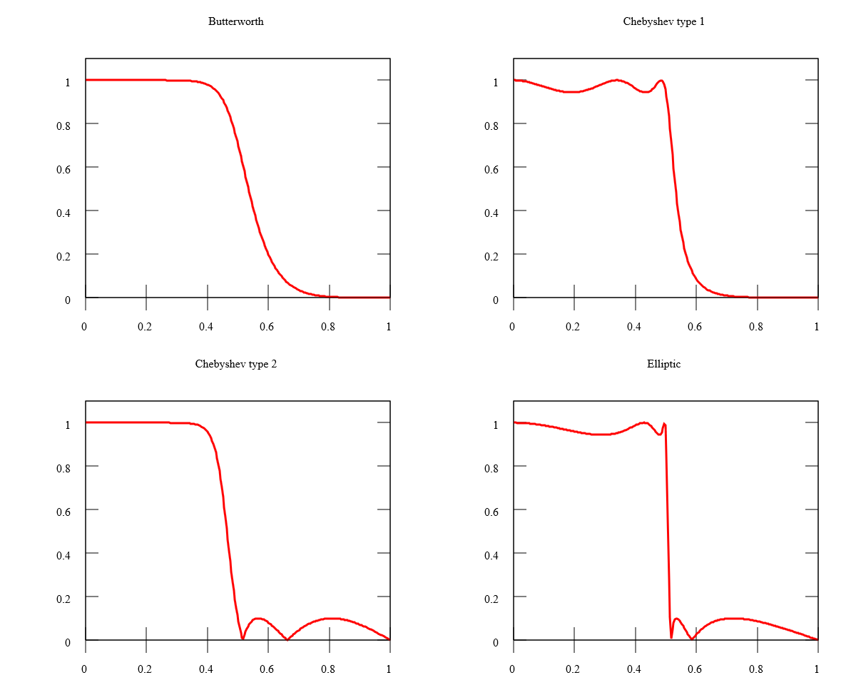
Comparison of Responses
The Butterworth filter has a frequency response that is as flat as possible in the passband (i.e., has no ripples) in the passband. It rolls off towards zero in the stopband.
Butterworth
Steeper rolloff than Butterworth filters, and have ripple in passband ripple (type I)
Chebyshev (type 1)
Chebyshev (type 2)
Elliptic
Steeper rolloff than Butterworth filters, and have ripple in stopband ripple (type II)
Equalized ripple (equiripple) behavior in both the passband and the stopband

Slide 7
Applications of Butterworth Filters
The Butterworth filter is typically used in data converter applications as an anti-aliasing filter because of its maximum flat pass band nature.
The radar target track display can be designed using Butterworth filter.
The Butterworth filters are frequently used in high quality audio applications.
Signal Conditioning: Sensors often produce noisy or unfiltered output signals. A Butterworth filter can be used to remove high-frequency noise and unwanted harmonics from the sensor signal, ensuring that only the relevant low-frequency information is passed through. This is crucial for obtaining accurate and reliable measurements.

Slide 8
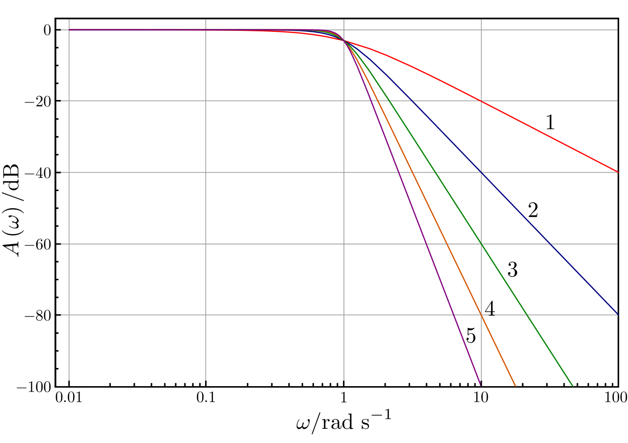
Order of Filter
The frequency response of a filter is generally represented using a Bode plot, and the filter is characterized by its cutoff frequency and rate of frequency rolloff.
In all cases, at the cutoff frequency, the filter attenuates the input power by half or 3 dB.
The order of the filter determines the amount of additional attenuation for frequencies higher than the cutoff frequency.
A first-order filter reduces the signal amplitude by half every time frequency doubles
A second-order filter attenuates high frequencies more steeply.

Slide 9
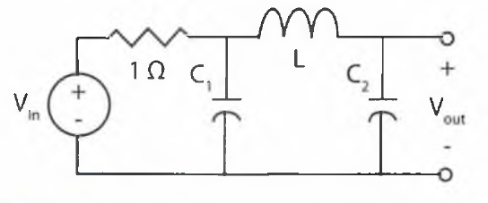
Butterworth Low Pass Filter – Passive Realization
The Butterworth filter can be realized using passive components such as series inductors and shunt capacitors.
The filters starting with the series elements are voltage driven and the filters starting with shunt elements are current driven.
The quality factor is Q=0.707, all high frequencies above the cut-off point band rolls down to zero at 20dB per decade or 6dB per octave in the stop band.

Slide 10
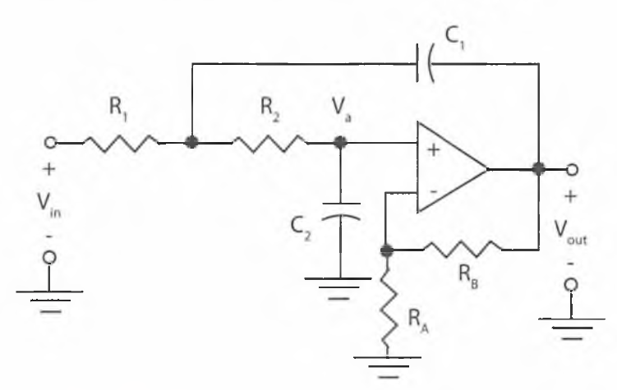
Butterworth Low Pass Filter – Active Realization
It can also be realized using passive components and active components such as resistors, capacitors, and operational amplifiers with Sallen-key topology.
The Sallen–Key topology is an electronic filter topology used to implement second-order active filters that is particularly valued for its simplicity.
The number of reactive elements used in the filter circuit will decide the order of the filter.

Slide 11
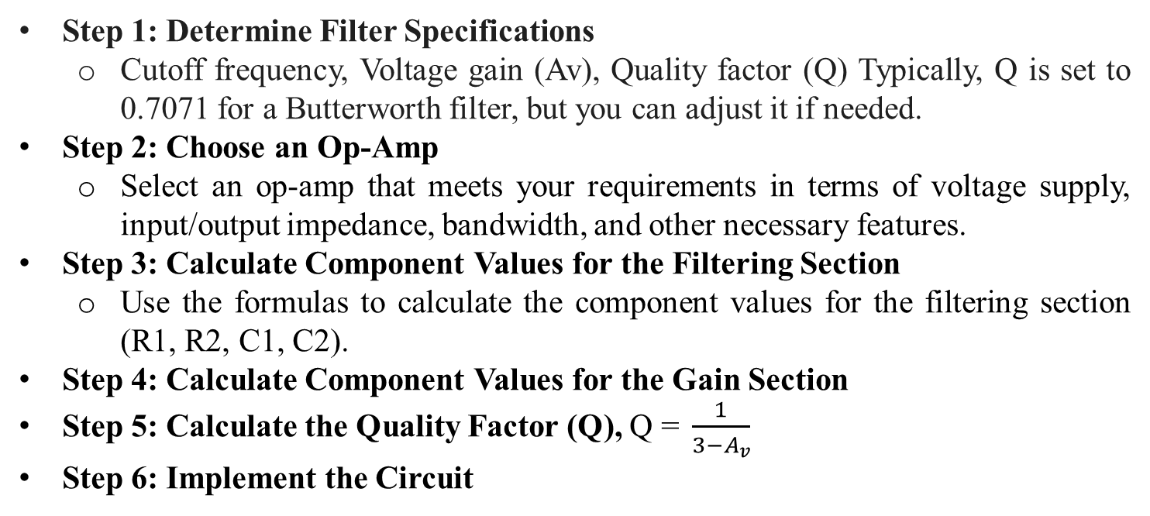
Butterworth Low Pass Filter – Active Realization
Step 1: Determine Filter Specifications
Cutoff frequency, Voltage gain (Av), Quality factor (Q) Typically, Q is set to 0.7071 for a Butterworth filter, but you can adjust it if needed.
Step 2: Choose an Op-Amp
Select an op-amp that meets your requirements in terms of voltage supply, input/output impedance, bandwidth, and other necessary features.
Step 3: Calculate Component Values for the Filtering Section
Use the formulas to calculate the component values for the filtering section (R1, R2, C1, C2).
Step 4: Calculate Component Values for the Gain Section
Step 5: Calculate the Quality Factor (Q), $\text{Q}\text{ = }\frac{1}{3−A_{v}}$
Step 6: Implement the Circuit

Slide 12
Answer the following questions using ChatGPT
Define the primary differences between passive and active filters. Why might you choose one over the other?
Explain the concept of a filter's order. How does the order affect the frequency response?
Why is the Butterworth filter commonly used for anti-aliasing in data converters?
What are the key differences between Chebyshev Type I and Type II filters?
Describe how the Sallen-Key topology is used in active filter design.

Slide 13
Summary
Passive vs active filter
Common types of filter: Butterworth, Chebyshev I, Chebyshev II, Elliptic
Order of Filter: Determines roll-off steepness
Bode Plot: Represents cutoff frequency and attenuation characteristics.
Application:
Signal Conditioning: Noise reduction in sensor signals.
Audio Systems: Ensures smooth frequency response.
Radar Systems: Enhances target tracking.
Data Converters: Anti-aliasing for precise measurement.

